Slide 1
Reliable Byte-Stream (TCP)
Outline
  Connection Establishment/Termination
  Sliding Window Revisited
  Flow Control
  Adaptive Timeout

Slide 2
End-to-End Protocols
Underlying best-effort network
  drop messages
  re-orders messages
  delivers duplicate copies of a given message
  limits messages to some finite size
  delivers messages after an arbitrarily long delay
Common end-to-end services
  guarantee message delivery
  deliver messages in the same order they are sent
  deliver at most one copy of each message
  support arbitrarily large messages
  support synchronization
  allow the receiver to flow control the sender
  support multiple application processes on each host

Slide 3
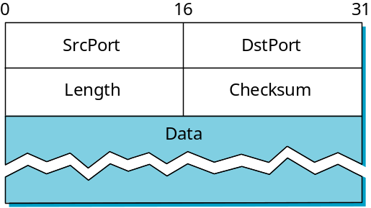
Simple Demultiplexor (UDP)
Unreliable and unordered datagram service
Adds multiplexing
No flow control
Endpoints identified by ports
  servers have well-known ports
  see /etc/services on Unix
Header format
Optional checksum
  psuedo header + UDP header + data

Slide 4
References
Cerf, V., and R. Kahn, "A Protocol for Packet Network Intercommunication", IEEE Transactions on Communications, Vol. COM-22, No. 5, pp 637-648, May 1974.
J. Postel, RFC-793 "Transmission Control Protocol" September 1981.
( Various errors and inconsistencies were detected)
Clarifications and bug fixes in RFC 1122 October 1989
Extensions in RFC 1323
Peterson and Davie , pp 378-405

Slide 5
TCP Overview
Connection-oriented
Byte-stream
  app writes bytes
  TCP sends segments
  app reads bytes
Full duplex
Flow control: keep sender from overrunning receiver
Congestion control: keep sender from overrunning network
Application process
Application process
Write
Read
bytes
bytes
TCP
TCP
Send buffer
Receive buffer
Segment
Segment
■ ■ ■
Segment
Transmit segments

Slide 6
Data Link Versus Transport
Potentially connects many different hosts
  need explicit connection establishment and termination
Potentially different RTT
  need adaptive timeout mechanism
Potentially long delay in network
  need to be prepared for arrival of very old packets
Potentially different capacity at destination
  need to accommodate different node capacity
Potentially different network capacity
  need to be prepared for network congestion

Slide 7
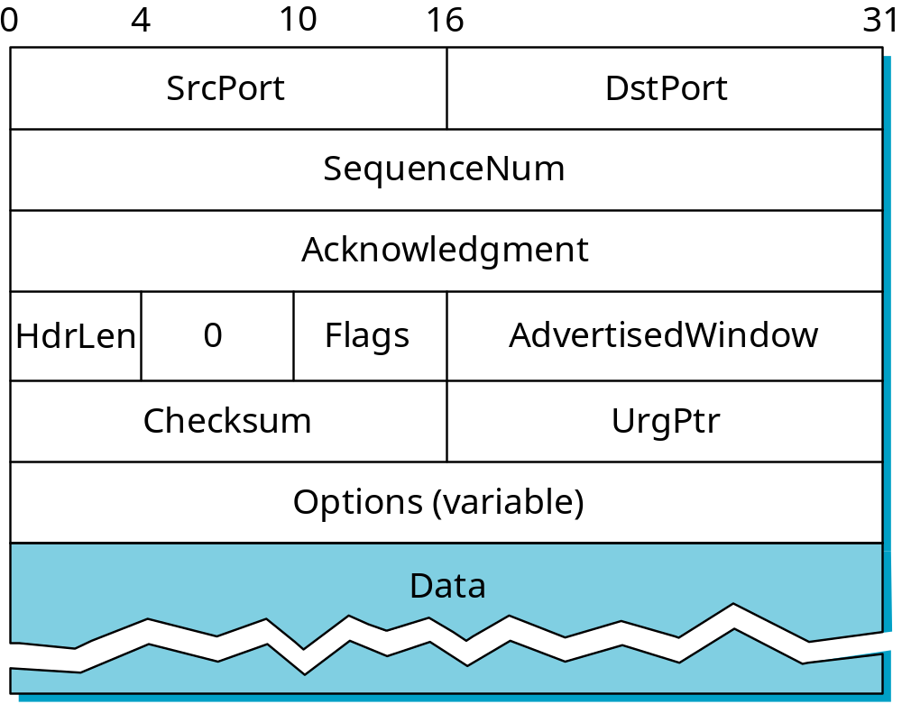
Segment Format

Slide 8
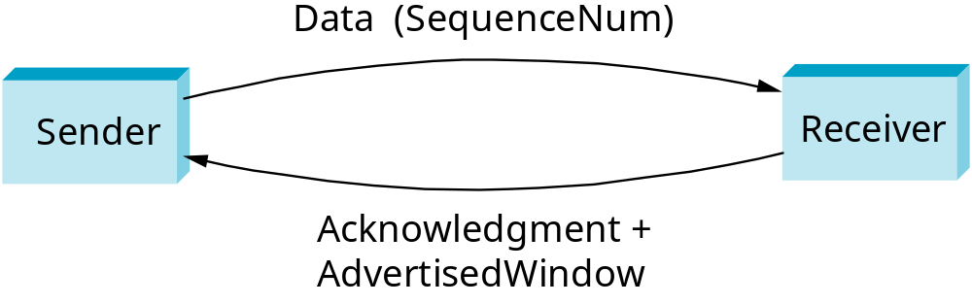
Segment Format (cont)
Each connection identified with 4-tuple:
  (SrcPort, SrcIPAddr, DsrPort, DstIPAddr)
Sliding window + flow control
  acknowledgment, SequenceNum, AdvertisedWinow
Flags
  SYN, FIN, RESET, PUSH, URG, ACK
Checksum
  pseudo header + TCP header + data

Slide 9
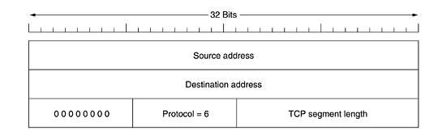
Checksum
Compute over TCP Header , Data and the seudoheader

Slide 10
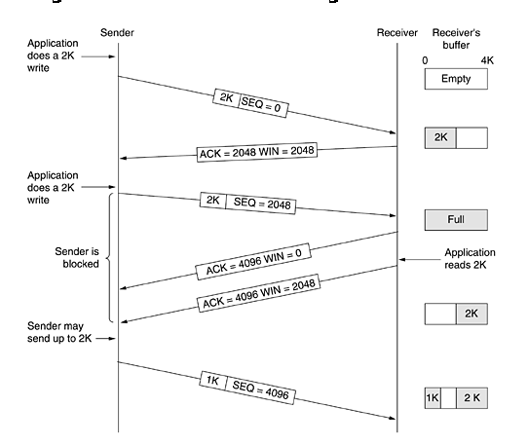
Window Management

Slide 11
Initial Sequence Number
Select initial sequence numbers (ISN) to protect against segments from prior connections (that may circulate in the network and arrive at a much later time)
Select ISN to avoid overlap with sequence numbers of prior connections
Use local clock to select ISN sequence number
Time for clock to go through a full cycle should be greater than the maximum lifetime of a segment (MSL); Typically MSL=120 seconds

Slide 12
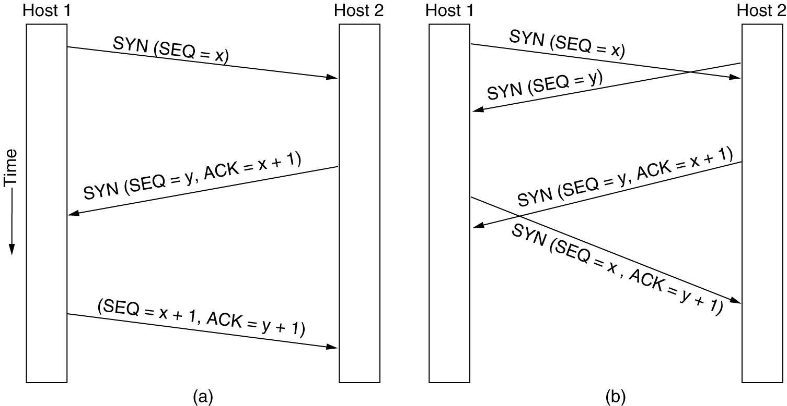
TCP Connection Establishment
6-31
(a) TCP connection establishment in the normal case.
(b) Call collision.
Initial sequence numbers are not 0. TCP uses a clock tick counter (at 4 usecs rate) to setup the initial sequence numbers. This scheme prevents delayed duplicates.

Slide 13
Connection Establishment (cont)
Active participant
Passive participant
(client)
(server)
SYN, SequenceNum =
x
SYN+ACK, SequenceNum=y,
Acknowledgment =x+1
ACK, Acknowledgment =y+1

Slide 14
TCP Connection Release
Graceful release:
  Each side of the connection released independently.
    Either side send TCP segment with FIN=1.
    When FIN acknowledged, that direction is shut down for data.
    Connection released when both sides shut down.
  4 segments: 1 FIN and 1 ACK for each direction; 1st. ACK+2nd. FIN combined.
  Two-army problem , Timers , 2 MSL

Slide 15
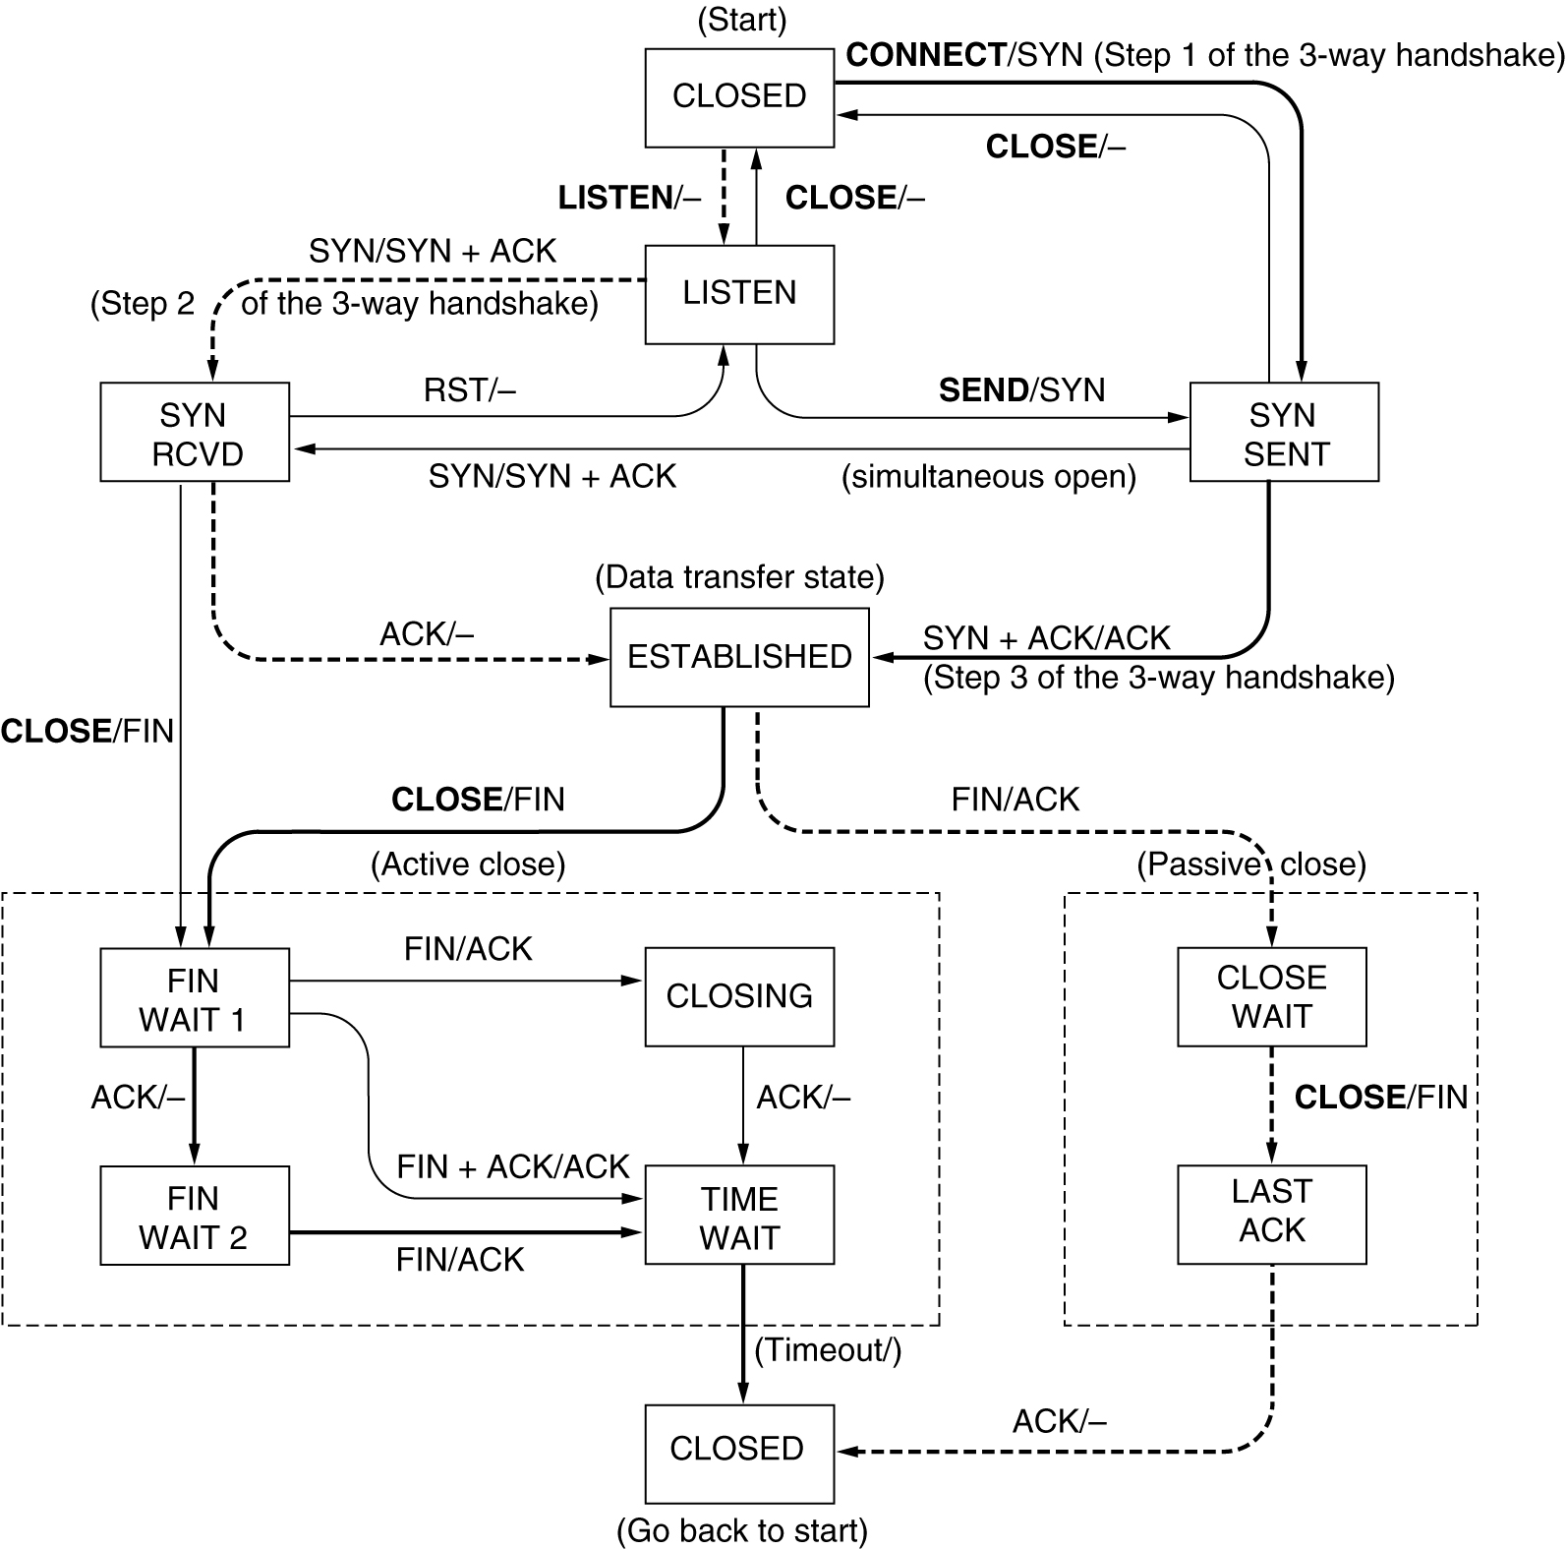
TCP Connection Management Modeling
TCP connection management finite state machine. The heavy solid line is the normal path for a client. The heavy dashed line is the normal path for a server. The light lines are unusual events. Each transition is labeled by the event causing it and the action resulting from it, separated by a slash.

Slide 16
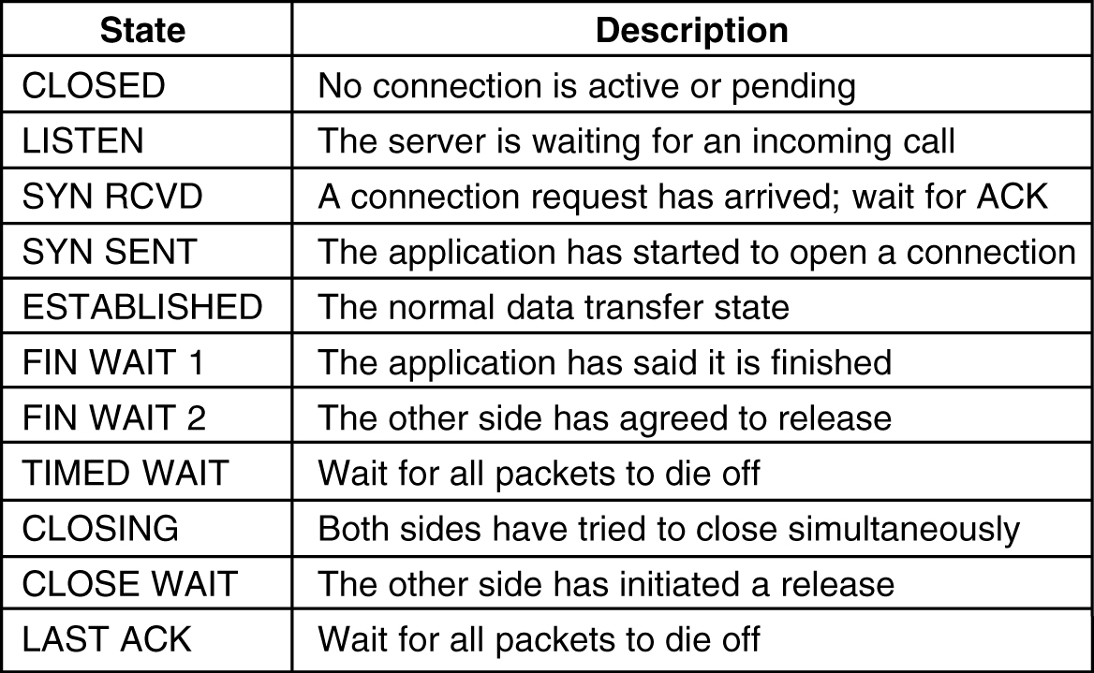
TCP Connection Management Modeling
The states used in the TCP connection management finite state machine.

Slide 17
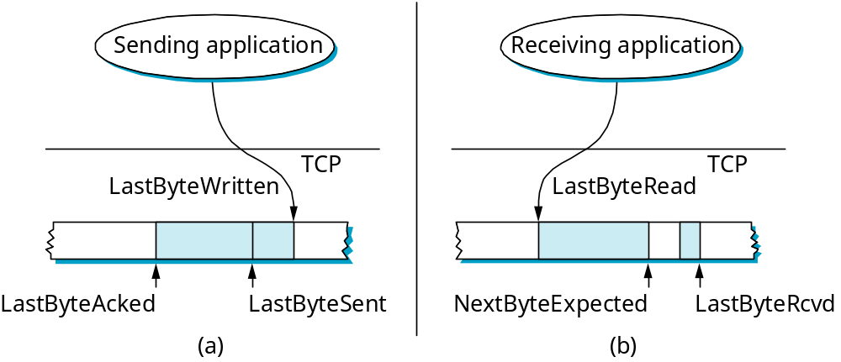
Sliding Window Revisited
Sending side
  LastByteAcked < = LastByteSent
  LastByteSent < = LastByteWritten
  buffer bytes between LastByteAcked and LastByteWritten
Receiving side
  LastByteRead < NextByteExpected
  NextByteExpected < = LastByteRcvd +1
  buffer bytes between NextByteRead and LastByteRcvd

Slide 18
Flow Control
Send buffer size: MaxSendBuffer
Receive buffer size: MaxRcvBuffer
Receiving side
  LastByteRcvd - LastByteRead < = MaxRcvBuffer
  AdvertisedWindow = MaxRcvBuffer - (NextByteExpected - NextByteRead)
Sending side
  LastByteSent - LastByteAcked < = AdvertisedWindow
  EffectiveWindow = AdvertisedWindow - (LastByteSent - LastByteAcked)
  LastByteWritten - LastByteAcked < = MaxSendBuffer
  block sender if (LastByteWritten - LastByteAcked) + y > MaxSenderBuffer
Always send ACK in response to arriving data segment
Persist when AdvertisedWindow = 0

Slide 19
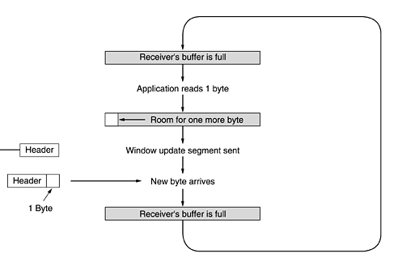
Silly Window Syndrome

Slide 20
Silly Window Syndrome (cont.)
How aggressively does sender exploit open window?
Receiver-side solutions
  after advertising zero window, wait for space equal to a maximum segment size (MSS)
  delayed acknowledgements
Sender
Receiver

Slide 21
Nagle’s Algorithm
How long does sender delay sending data?
  too long: hurts interactive applications
  too short: poor network utilization
  strategies: timer-based vs self-clocking
When application generates additional data
  if fills a max segment (and window open): send it
  else
    if there is unack’ed data in transit: buffer it until ACK arrives
    else: send it

Slide 22
Nagle's algorithm
Purpose is to allow the sender TCP to make efficient use of the network, while still being responsive to the sender applications.
Idea:
If application data comes in byte by byte, send first byte only. Then buffer all application data till until ACK for first byte comes in. If network is slow and application is fast, the second segment will contain a lot of data.
Send second segment and buffer all data till ACK for second segment comes in.
This way the algorithm is clocking the sends to speed of the network and simultaneously preventing sending several one byte segments back to back.
An exception to this rule is to always send (not wait for ACK) if enough data for half the receiver window or MSS.

Slide 23
Protection Against Wrap Around
32-bit SequenceNum
Bandwidth Time Until Wrap Around
T1 (1.5 Mbps) 6.4 hours
Ethernet (10 Mbps) 57 minutes
T3 (45 Mbps) 13 minutes
FDDI (100 Mbps) 6 minutes
STS-3 (155 Mbps) 4 minutes
STS-12 (622 Mbps) 55 seconds
STS-24 (1.2 Gbps) 28 seconds

Slide 24
Keeping the Pipe Full
16-bit AdvertisedWindow
Bandwidth Delay x Bandwidth Product
T1 (1.5 Mbps) 18KB
Ethernet (10 Mbps) 122KB
T3 (45 Mbps) 549KB
FDDI (100 Mbps) 1.2MB
STS-3 (155 Mbps) 1.8MB
STS-12 (622 Mbps) 7.4MB
STS-24 (1.2 Gbps) 14.8MB
assuming 100ms RTT

Slide 25
TCP Options
Some TCP options are:
Maximum segment size (MSS): Specified what is the payload the sender is able to receive. (Default MSS = 536 bytes, i.e., Segment size = MSS + 20). SMSS/RMSS is Sender/Receiver MSS.
Window scale: The window size field allows for upto 2^16 bytes of data. But this might be inefficient for high bw x delay situations. This options TCP indicate a scaling factor.
Negative acknowledgement: Lets receiver user NAKs to get realize selective repeat rather than the normal go-back-N TCP behaviour.

Slide 26
TCP Extensions
Implemented as header options
Store timestamp in outgoing segments
Extend sequence space with 32-bit timestamp (PAWS)
Shift (scale) advertised window

Slide 27
TCP Timer Management
Of the several timers TCP maintains the most important is the retransmission timer RTO, (also called timeout) . After each segment is sent, TCP starts a retransmission timer, if ACK arrives before timer expires, cancel timer. If timer expires first, consider segment lost.
How long should RTO be ?
Typically some small multiple of RTT.
So how to measure RTT ?
Measure time between segment sent and ACK receiver.
Unfortunately, in the Internet RTT are not constant, they a vary a lot.

Slide 28
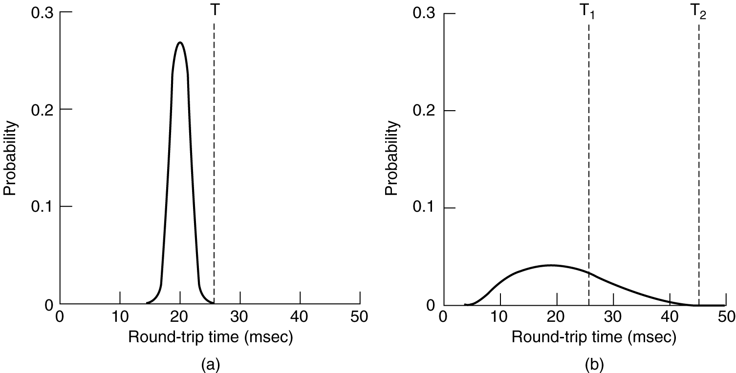
TCP Timer Management
(a) Probability density of ACK arrival times in the data link layer.
(b) Probability density of ACK arrival times for TCP.

Slide 29
Adaptive Retransmission
(Original Algorithm)
Measure SampleRTT for each segment / ACK pair
Compute weighted average of RTT
  EstRTT = α x EstRTT + β x SampleRTT
  where α + β = 1
  α between 0.8 and 0.9
  β between 0.1 and 0.2
Set timeout based on EstRTT
  TimeOut = 2 x EstRTT

Slide 30
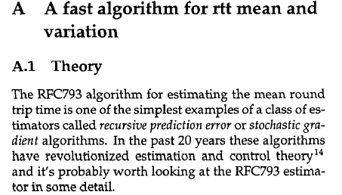
Jacobson ( 1988)

Slide 31
Jacobson/ Karels Algorithm
New Calculations for average RTT
Diff = SampleRTT - EstRTT
EstRTT = EstRTT + (δ x Diff)
Dev = Dev + δ( |Diff| - Dev)
  where δ is a factor between 0 and 1
Consider variance when setting timeout value
TimeOut = μ x EstRTT + φ x Dev
  where μ = 1 and φ = 4
Notes
  algorithm only as good as granularity of clock (500ms on Unix)
  accurate timeout mechanism important to congestion control (later)

Slide 32
RTO ( Ret. Timeout) exceptions
Assume a segment times out and is then retransmitted. An ACK for the segment arrives.
So for purposes for calculating M how do we decide if the ack is for the first send or the retransmission ?
We cannot. It might be for the first, but very delayed, or might be for the second. So we cannot use ACKs of retransmitted segments for calculating M (or updating RTT).
Rule: Don't use acks of retransmitted segments to update RTT. Instead, if segment times out, simply double RTO.
This is called the Karn's algorithm.

Slide 33
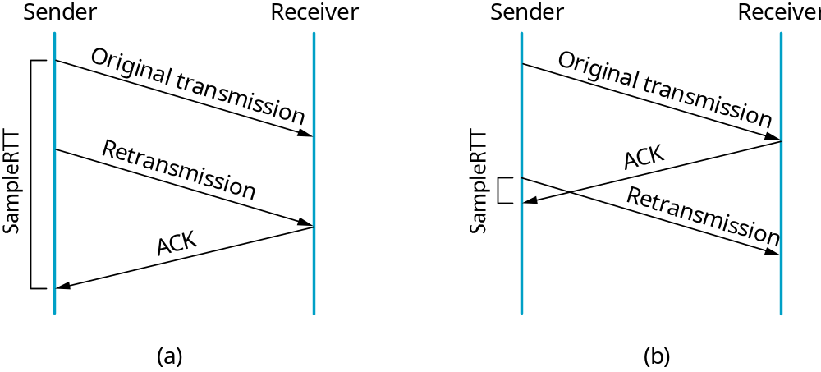
Karn/Partridge Algorithm
Do not sample RTT when retransmitting
Double timeout after each retransmission

Slide 34
Maximum Segment Size
Maximum Segment Size
  largest block of data that TCP sends to other end
Each end can announce its MSS during connection establishment
Default is 576 bytes including 20 bytes for IP header and 20 bytes for TCP header
Ethernet implies MSS of 1460 bytes
IEEE 802.3 implies 1452

